Slide 1
Topic :Ratios
Term 4
Year 7 – Ratio & Rates
EQ: What are ratios and how do we use them?

Slide 2
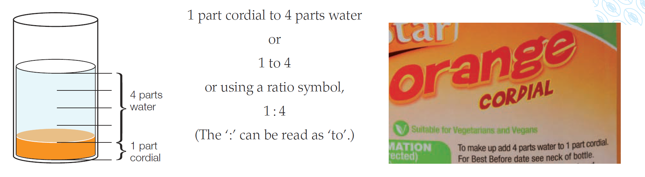
Topic : Ratios
What are ratios and how do we use them?
Ratio
A ratio is a comparison of two quantities of the same type in the same units

Slide 3
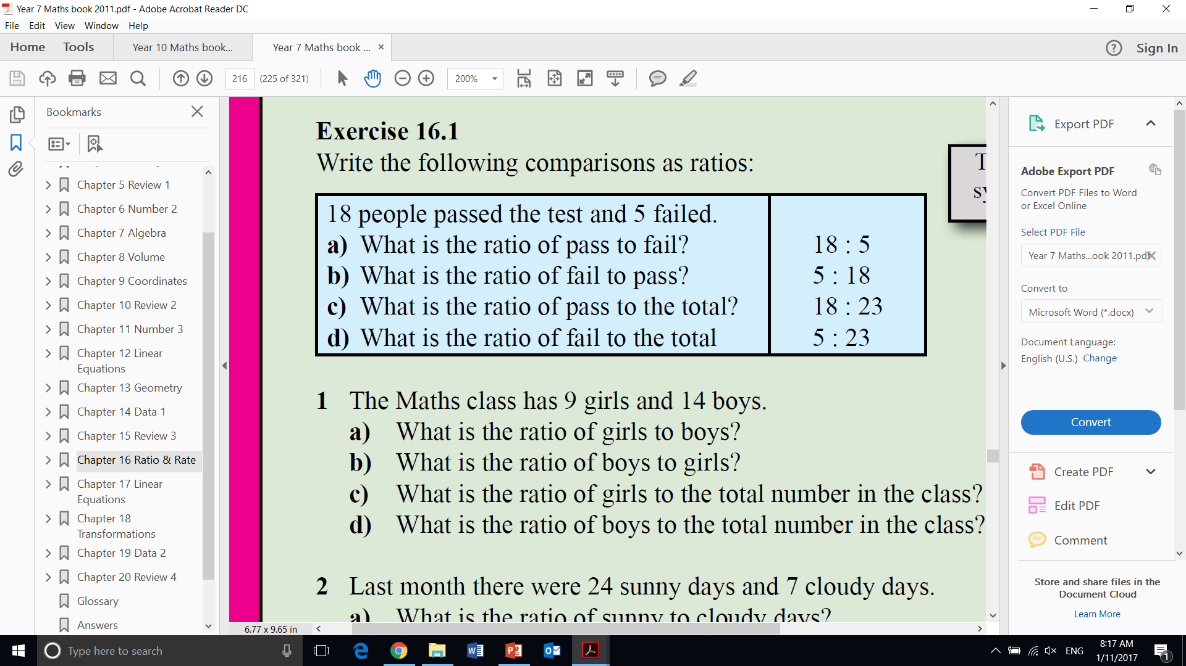
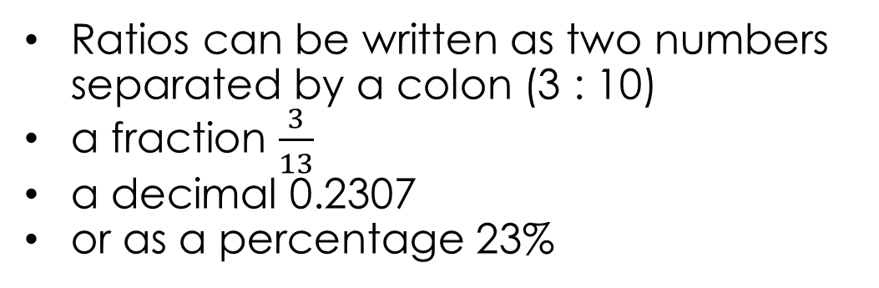
Topic : Ratios
What are ratios and how do we use them?
Ratio
A ratio is a comparison of two quantities of the same type in the same units
Ratios can be written as two numbers separated by a colon (3 : 10)
a fraction $\frac{3}{13}$
a decimal 0.2307
or as a percentage 23%
How can ratios be represented?

Slide 4
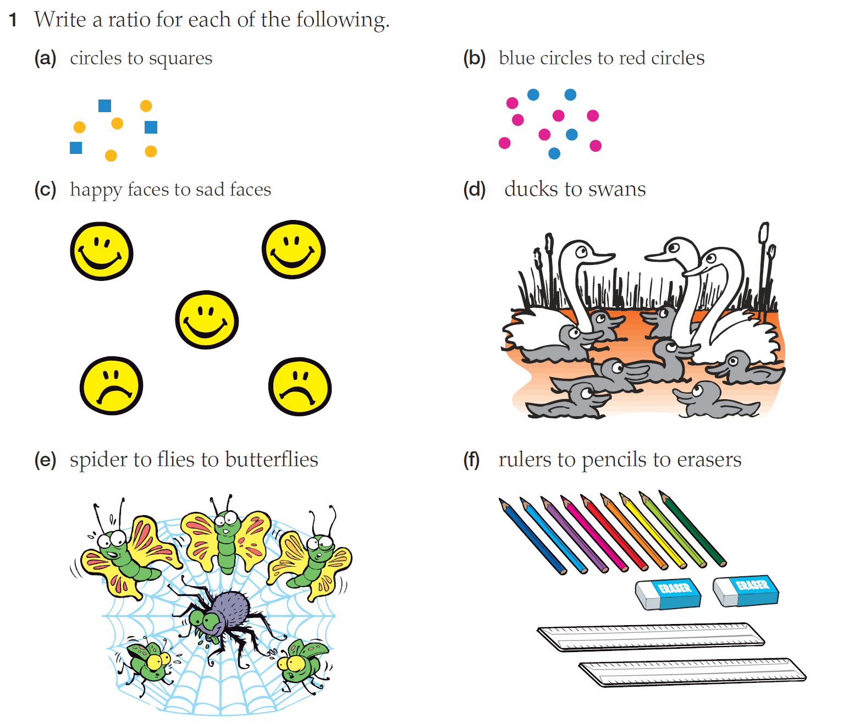

Slide 5
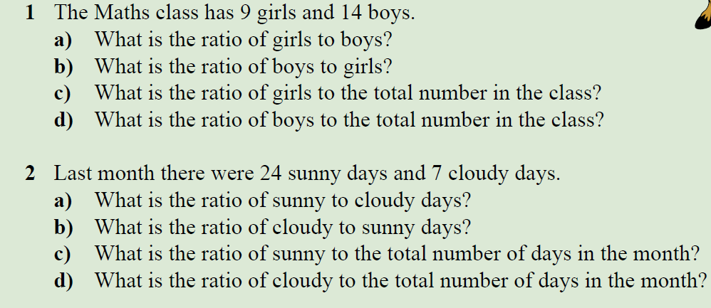
Practice

Slide 6
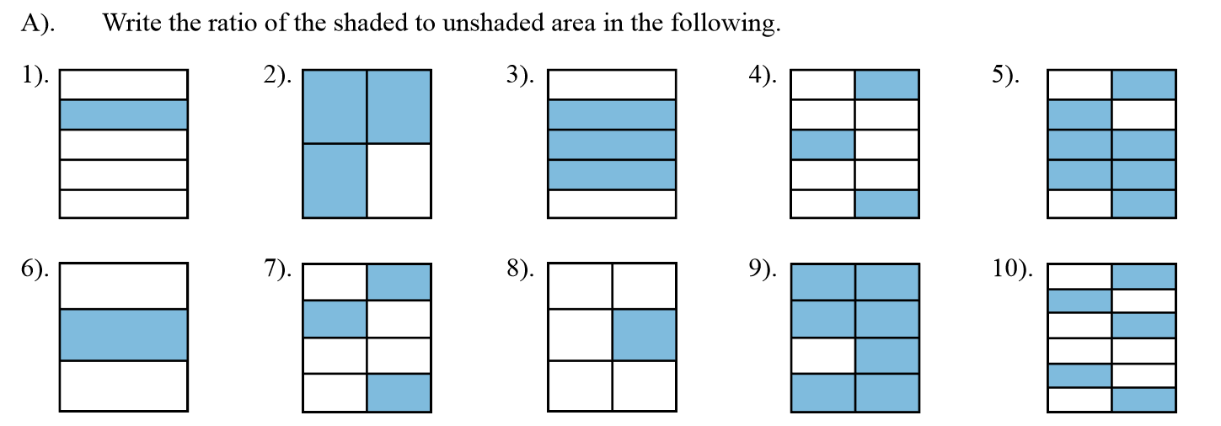

Slide 7
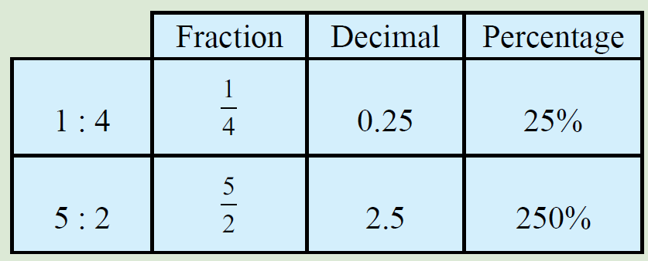
Topic : Ratios
What are ratios and how do we use them?
Converting between fraction decimal and percentage
Fraction → decimal
divide numerator by denominator
Decimal → percentage
multiply by 100 and add the percentage symbol %

Slide 8
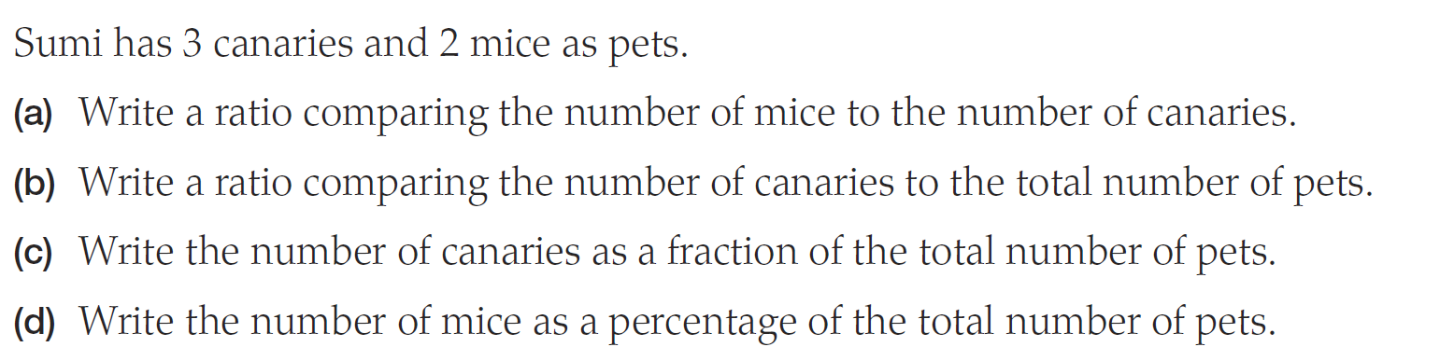
Practice

Slide 9
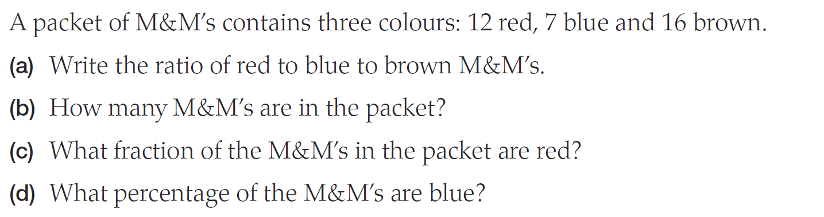
Practice

Slide 10
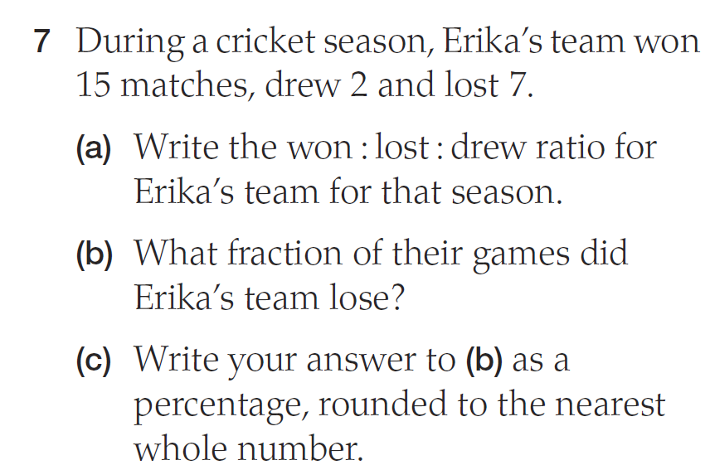
Practice

Slide 11
Write your summary
Sentence frame
A ratio is ______________
We can use ratios to _______
To convert ratios to fractions we_________

